Slide 1
DATA VISUALIZATION LECTURE 4
11/03/2022

Slide 2
QUOTE
If you torture the data long enough, it will tell you anything.
-John W. Tukey

Slide 3

CHALLENGES IN DATA VISUALIZATION
1. Misleading Color Contrast

Slide 4
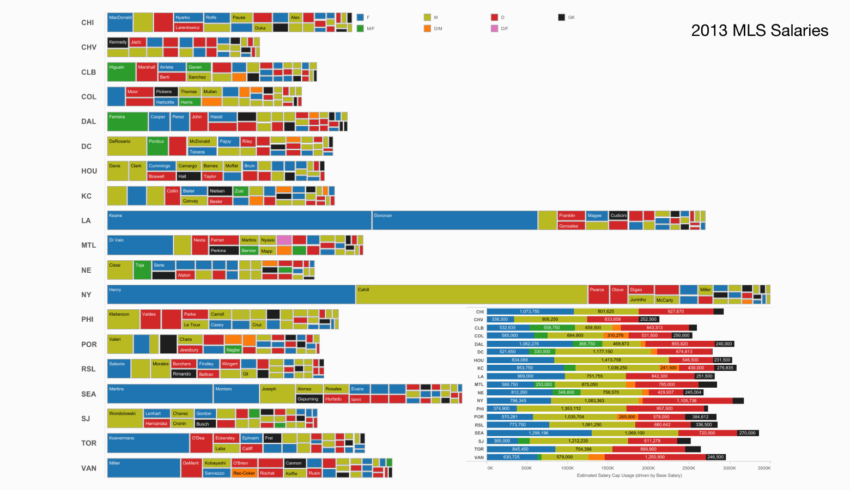
contd
Too Much Data

Slide 5
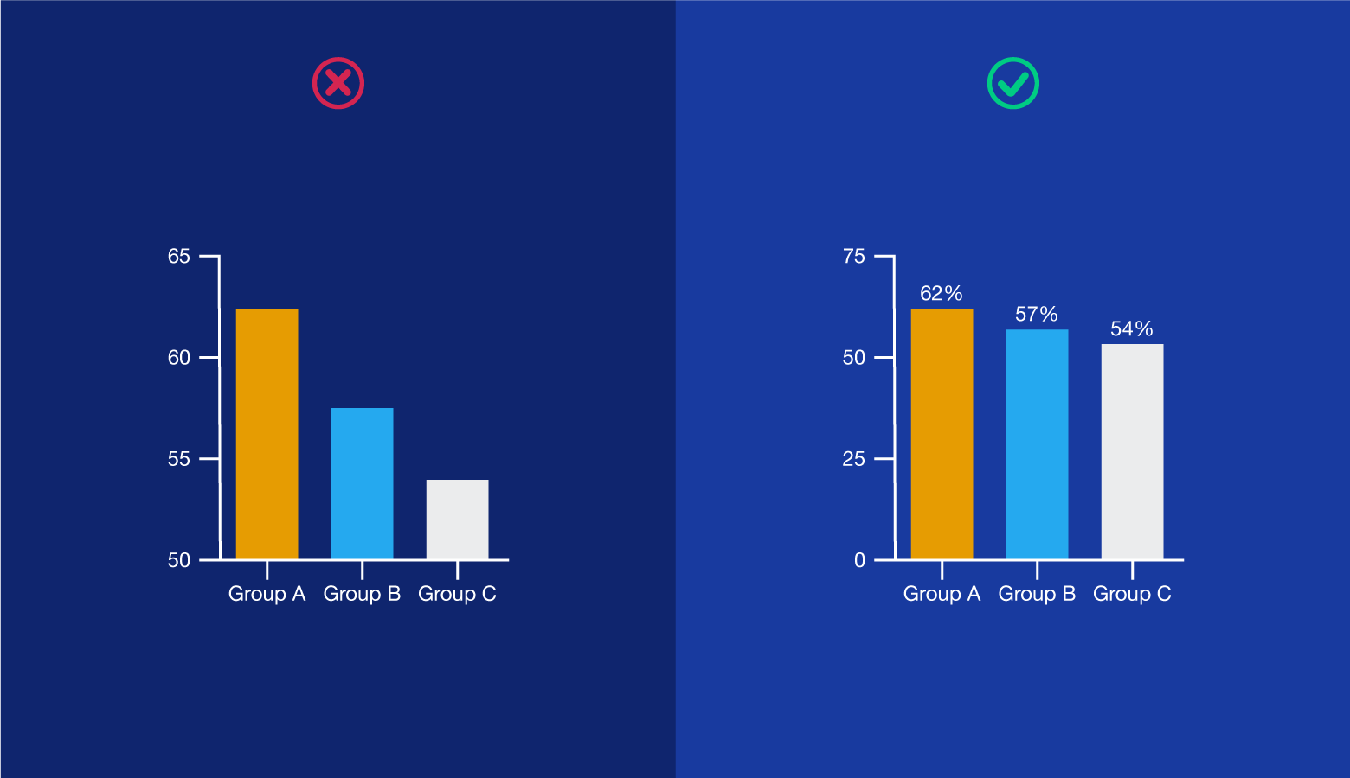
contd
Omitting Baselines and Truncating Scale

Slide 6
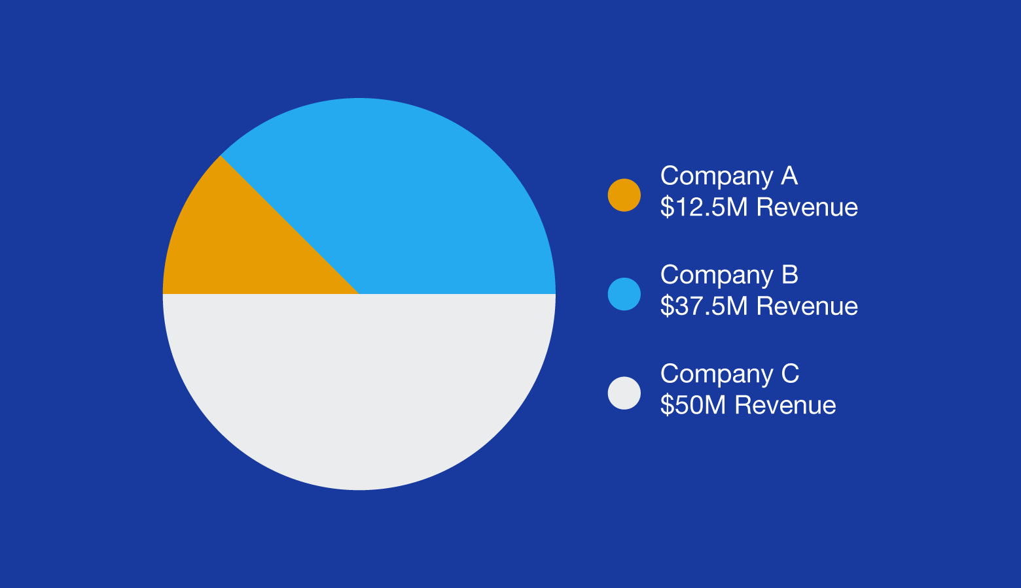
Contd.
Choosing the Wrong Visualization Method
Pie charts are meant for comparing the parts of a whole. Using them to compare separate datasets, like the earnings of different companies, provides viewers with little insight.

Slide 7
Types of DATA
In its simplest form, each observation or variable of a data record represents a single piece of information.
We can categorize this information as being ordinal (numeric) or nominal (non-numeric).
Subcategories of each can be readily defined

Slide 8
ODINAL
Ordinal. The data take on numeric values:
• binary—assuming only values of 0 and 1;
• discrete—taking on only integer values or from a specific subset (e.g., (2, 4, 6));
• continuous—representing real values (e.g., in the interval [0, 5])

Slide 9
Contd.
Ordinal Data
Ordinal data have natural ordering where a number is present in some kind of order by their position on the scale. These data are used for observation like customer satisfaction, happiness, etc., but we can’t do any arithmetical tasks on them.

Slide 10
contd
Examples of Ordinal Data :
When companies ask for feedback, experience, or satisfaction on a scale of 1 to 10
Letter grades in the exam (A, B, C, D, etc.)
Ranking of peoples in a competition (First, Second, Third, etc.)
Economic Status (High, Medium, and Low)
Education Level (Higher, Secondary, Primary)

Slide 11
nOMINAL
Nominal. The data take on non-numeric values:
• categorical—a value selected from a finite (often short) list of possibilities (e.g., red, blue, green);
• ranked—a categorical variable that has an implied ordering (e.g., small, medium, large);
• arbitrary—a variable with a potentially infinite range of values with no implied ordering (e.g., addresses)

Slide 12
Nominal Data
The name “nominal” comes from the Latin name “nomen,” which means “name.” With the help of nominal data, we can’t do any numerical tasks or can’t give any order to sort the data. These data don’t have any meaningful order; their values are distributed to distinct categories.
Examples of Nominal Data :
Colour of hair (Blonde, red, Brown, Black, etc.)
Marital status (Single, Widowed, Married)
Nationality (Indian, German, American)
Gender (Male, Female, Others)
Eye Color (Black, Brown, etc.)

Slide 13
Difference between Nominal and Ordinal Data
Nominal data can’t be quantified, neither they have any intrinsic ordering
Ordinal data give some kind of sequential order by their position on the scale
Nominal data is qualitative data or categorical data
Ordinal data is said to be “in-between” of qualitative data and quantitative data
They don’t provide any quantitative value, neither we can perform any arithmetical operation
They provide sequence and can assign numbers to ordinal data but cannot perform the arithmetical operation
Nominal data cannot be used to compare with one another
Ordinal data can help to compare one item with another by ranking or ordering

Slide 14
Scale
Three attributes that define a variable’s measure are as follows:
• Ordering relation, with which the data can be ordered in some fashion. By definition, ranked nominal variables and all ordinal variables exhibit this relation.
• Distance metric, with which the distances can be computed between different records.
This measure is clearly present in all ordinal variables but is generally not found in nominal variables.

Slide 15
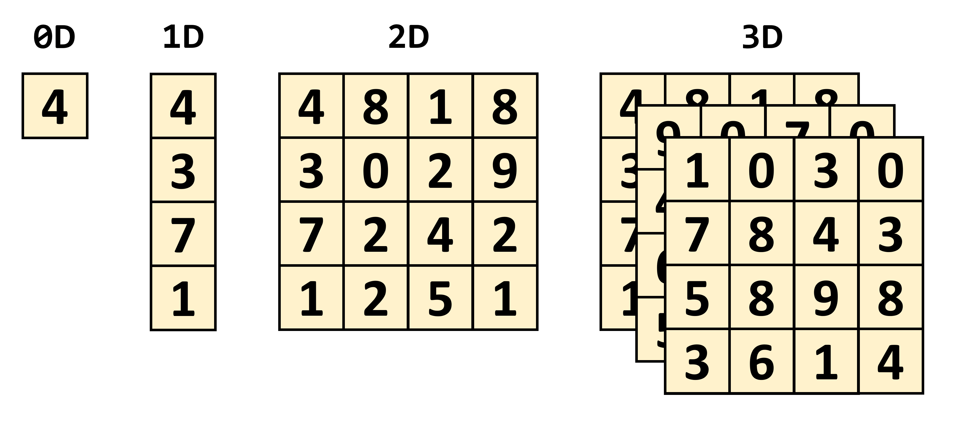
dinmensionality

Slide 16
Scalars and vectors
Scalars: Scalars are mathematical entities that have only a magnitude­ (and no direction). Physical examples include mass and energy.
Vectors: Vectors are mathematical entities that have both a magnitude and a direction. Physical examples include forces, velocities, momenta, and locations.

Slide 17
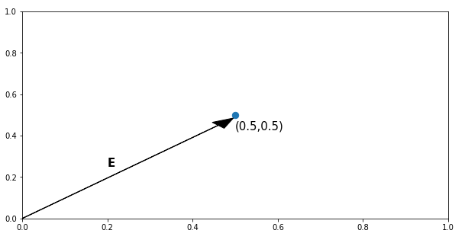
Plotting of vector
To plot a vector we use its elements as the value of coordinates (x, y and z axis respectively). Here, first element (0.5) is taken as x value and second element (also, 0.5) is taken as y value (if we had three elements, the third one would’ve been z value).
After plotting the vector as a point we put an arrow to it, from the origin(0,0).
A vector is simply a matrix that has either one row (called column vector) or one column (called row vector).

Slide 18
Contd.
Scalar
A scalar is 0 rank tensor. In physics, various quantities are represented as a scalar such as : Distance (500 km), Temperature (10ºC), Speed (34 km/h), etc.
Vector
A rank 1 tensor is called a vector. Physical quantities such as Velocity (10 m/s), Displacement (54 m towards East), Electromagnetic Field (1 V/m).
Difference between scalar and vector :
A quantity that does not require additional information (such as direction) with it (like, temperature) is represented as scalar. Whereas, a quantity that needs direction to be specified alongside its magnitude is represented with a vector (like, electric field).

Slide 19
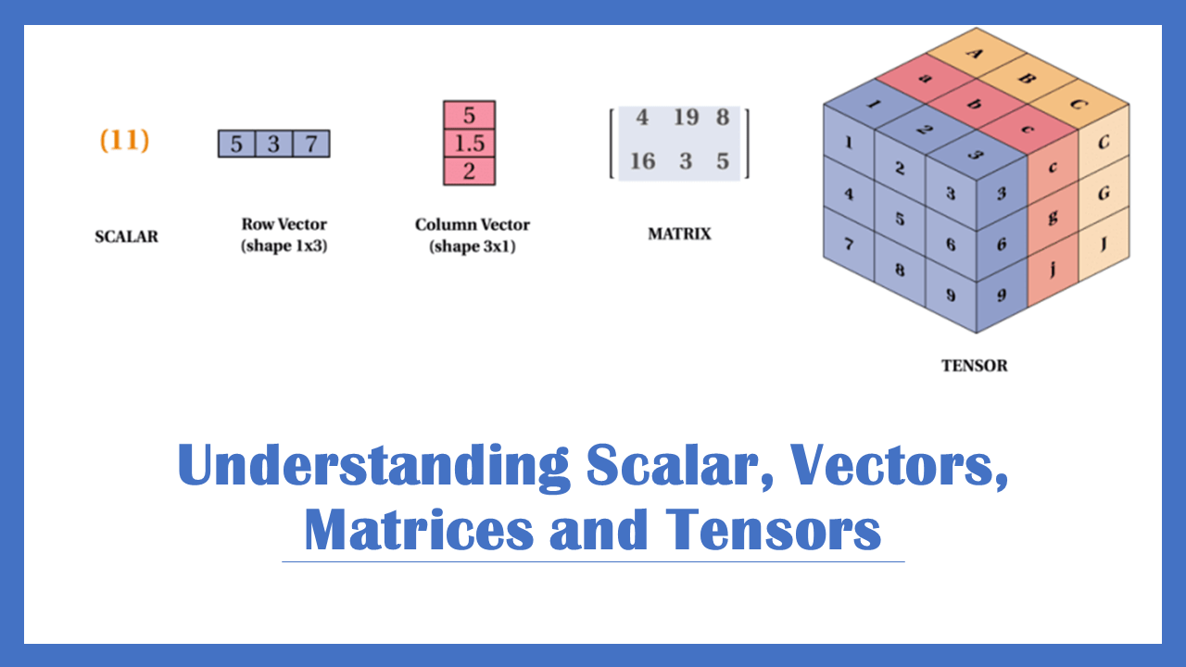
tensors
Tensor
An tensor is an array of data (numbers, functions, etc.) that is expanded in any number (0 and greater) of dimensions. The number of dimensions is called the rank of the tensor.

Slide 20
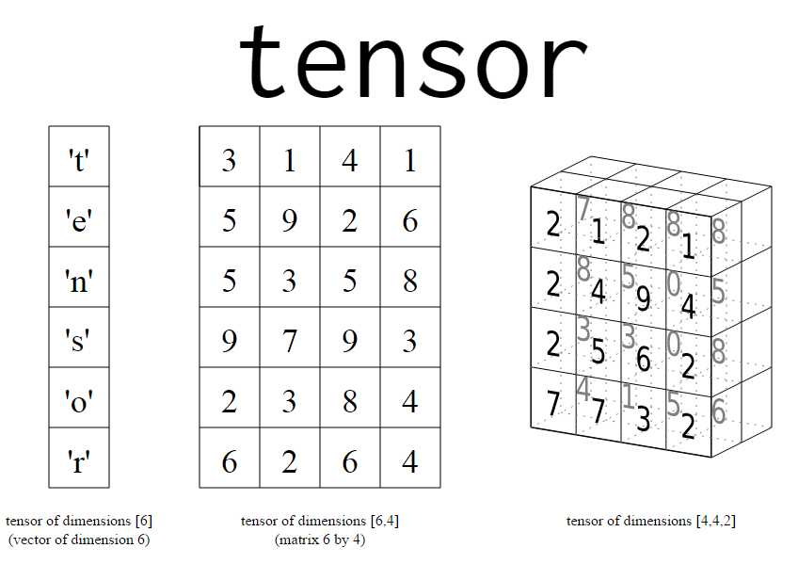
Dimensionality of a tensor

Slide 21
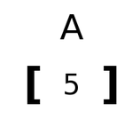
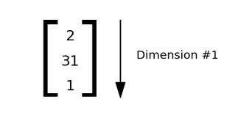
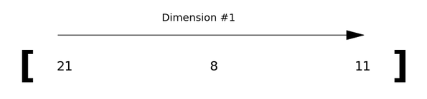
Rank of tensor
Rank 1 tensor
A tensor that is expanded in only one dimension.
Rank 0 tensor
A tensor that has no dimensions (0).

Slide 22
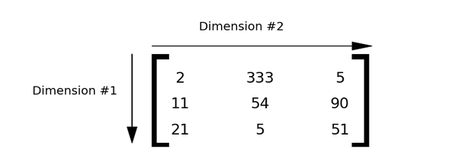
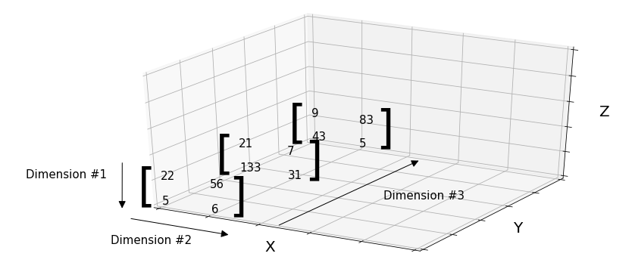
Ranks of tensors
Rank 2 tensor
Rank 3 tensor

